Slide 1

ANNAMACHARYA INSTITUTE OF TECHNOLOGY AND SCIENCES::TIRUPATI (AUTONOMOUS) Artificial Intelligence and Data Science A.Y.: 2025-2026 PROJECT REVIEW Implementation of Text-to-Image Generators in Designing Usability Interfaces for Web Page Construction
Under the Guidance of
Ms.K.Gangothri, MCA
Assistant Professor
Department of AI&DS
AITS, Tirupati
Head of the Department
Mrs.B.Rupa Devi Singh, M. Tech (PhD)
Associate Professor
Department of AI&DS
AITS, Tirupati
AI&DS-2 : Batch No-11
22AK1A3057 NARAYANA VARA PRASD REDDY Y
22AK1A3065 PRABHAS V
22AK1A3074 SALEEM BASHA S
22AK1A3092 VENKATA ASHISH RAJ K

Slide 2
ABSTRACT
Modern web design is becoming more complex, as users expect visually attractive and user-friendly interfaces. Traditional design methods take a lot of time because designers manually create graphics and repeatedly test different design.This project introduces an AI-based system that generates web design visuals from text descriptions. Using tools like DALL·E and Stable Diffusion, the system can quickly create high-quality images based on user input. Image generation is improved using a structured prompt process to ensure the designs are accurate and consistent. The generated visuals are then checked using UI/UX factors such as layout, color balance, and accessibility to maintain usability.

Slide 3
PROBLEM STATEMENT
Web design today requires attractive and user-friendly interfaces, but creating visual elements manually is time-consuming and requires strong design skills. Traditional methods depend heavily on designers to create graphics, which slows down the development process and limits creativity.
Key Challenges:
Dependence on skilled designers for creating visuals
Time-consuming manual design and repeated revisions
Limited creativity due to use of pre-made templates and assets
Hard to quickly create unique visuals for different needs
Multiple changes and feedback cycles slow down progress

Slide 4
OBJECTIVES
The primary objective of this project is to design an AI-based system for generating web design visuals from textual descriptions by integrating generative AI and UI/UX principles. The system uses text-to-image models to automate visual creation and improve design efficiency.
Objectives:
To develop an AI-driven text-to-image generation system for web design
To generate visuals automatically from user-provided text prompts
To integrate generated images into web interfaces (HTML, CSS, JavaScript)
To evaluate outputs based on UI/UX factors like layout, color, and usability
To reduce manual effort and dependency on designers
To improve creativity and flexibility in web development

Slide 5
LITERATURE SURVEY
S. No | Title of the Paper | Author Names | Problem Statement | Year of Published
1 | High-Resolution Image Synthesis with Latent Diffusion Models | Robin Rombach | Existing models struggled with high-quality image generation and high computational cost | 2022
2 | DALL-E: Creating Images from Text | Aditya Ramesh | Need to generate images directly from natural language descriptions | 2021
3 | Diffusion Models Beat GANs on Image Synthesis | Prafulla Dhariwal, Alexander Nichol | GAN models faced instability and poor image quality in some cases | 2021

Slide 6
S. No | Title of the Paper | Author Names | Problem Statement | Year of Published
4 | Learning Transferable Visual Models from Natural Language Supervision (CLIP) | Alec Radford | Difficulty in connecting text understanding with image generation | 2021
5 | Photo realistic Text-to-Image Diffusion Models | Chitwan Saharia | Need for more realistic and accurate image generation from text | 2022
6 | Adding Conditional Control to Text-to-Image Diffusion Models (ControlNet) | Lvmin Zhang | Lack of control over generated image structure and details | 2023

Slide 7
EXISTING SYSTEM & LIMITATIONS
In traditional web design systems, visual elements are created manually by designers using tools like graphic editors and UI design software. The process depends heavily on human creativity, predefined templates, and repeated design iterations to build web interfaces.
Techniques Used:
Manual design of graphics using tools (Figma, Photoshop, etc.)
Use of pre-designed templates and UI components
Basic rule-based design approaches and static layouts
Stable Diffusion For Generates images from text prompts
Limitations:
Image generation can be slow without GPU support
Poor text input leads to inaccurate outputs
Difficult to get exact layout or specific design elements
Some outputs may be blurry or less detailed
Multiple generated images may not match the same style/theme perfectly

Slide 8
PROPOSED SYSTEM
The proposed system introduces an AI-based text-to-image generation approach for designing web interfaces by integrating Generative AI with web development technologies. It uses advanced models to convert textual descriptions into high-quality visual elements, improving design efficiency and creativity.
Key Features:
Text-to-Image Generation converts user text prompts into visual design elements
Reduces manual effort in creating graphics by using Automated Design Process
Improves accuracy and consistency of generated images by Prompt Engineering Support
Uses Generative AI like Stable Diffusion for image generation
Easily integrates images into web pages (HTML, CSS, JavaScript)

Slide 9
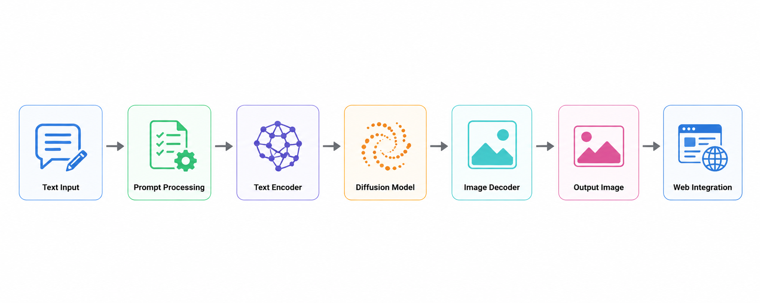
MODEL ARCHITECTURE
The model architecture of this project is based on a Generative AI text-to-image framework, specifically using a diffusion-based model such as Stable Diffusion to generate visual elements for web interfaces from textual input. The system begins with the user providing a descriptive text prompt that defines the desired visual content, such as a banner, icon, or background for a web page.

Slide 10
Model Components:
Input Layer: User enters text prompt through Django web interface.
Prompt Processing → Enhances text using prompt engineering (style, quality, clarity)
Text Encoder (CLIP) → Converts text into numerical embeddings (understands meaning)
Diffusion Model (Stable Diffusion) → Generates image from noise using text guidance
Post-Processing → Adjusts size, resolution, and format for web usage
Web Integration Layer → Displays output using HTML, CSS, JavaScript (Django backend)
Training Configuration:
Pretrained Model → Uses pretrained Stable Diffusion (no heavy training required)
Inference Process → Generates images based on input prompts
Parameter Tuning → Adjusts steps, guidance scale for better output quality

Slide 11
SYSTEM WORKFLOW
User Input:
The process begins with the user registering or logging into the web application and providing a natural language text prompt describing the desired image. The user also selects a preferred image style (Realistic, Iconic, or Algerian).
Prompt Preprocessing and Enhancement:
The raw user prompt undergoes validation and enhancement. Style-specific keywords and quality boosters are added to improve semantic richness. A set of negative prompts is also applied to suppress unwanted artifacts such as blur, distortion, and low quality.
Diffusion Process (Core Generation):
The text embeddings are fed into the Stable Diffusion pipeline. The model starts with random noise in the latent space and iteratively denoises it over multiple steps (typically 45 steps) guided by the text embeddings to generate a coherent latent image representation.
Image Decoding:
The latent representation is passed through the Variational Autoencoder (VAE) decoder to produce the final high-quality image in pixel space.
Output Display:
The generated image is displayed to the user on the web interface along with options to download or generate new variations.

Slide 12
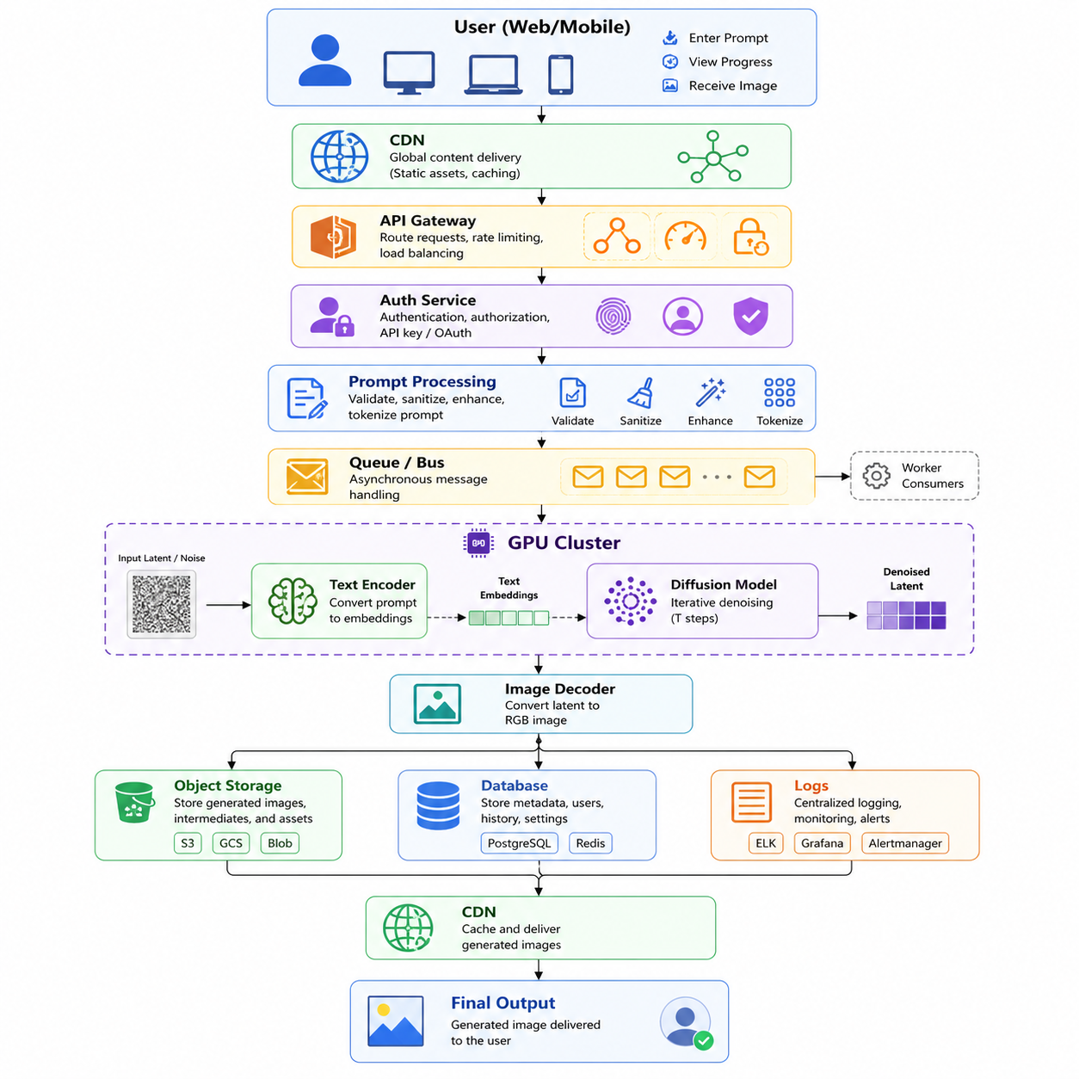
COMPLETE FEATURE ENGINEERING PIPELINE

Slide 13
PERFORMANCE EVALUATION METRICS
Prompt Adherence: Measures how accurately the generated image reflects the content, objects, and intent described in the user’s text prompt.
Visual Quality: Assesses the overall clarity, sharpness, detail, and aesthetic appeal of the generated images. Factors such as resolution, color harmony, and absence of artifacts (blur, distortion, noise) are considered.
Creativity and Diversity: Measures the model’s ability to generate varied and visually appealing outputs for similar prompts, which is essential for creative design tasks.
User Satisfaction: Subjective feedback on the usefulness and relevance of the generated images for web page design and interface construction.
Evaluation Approach:
Multiple test prompts covering different categories (landscapes, objects, abstract designs, web banners, etc.) were used.
Outputs were visually inspected and compared across different styles and prompts

Slide 14
RESULTS & ANALYSIS
A diverse set of test prompts covering various categories (web banners, landscapes, UI elements, abstract designs, and objects) was used to analyze the system’s effectiveness. The evaluation focused on the quality and usability of the generated images for web page interface design.
The system produces high-quality, visually appealing images with good prompt adherence, successfully translating user textual descriptions into relevant visuals.
The use of prompt enhancement techniques and negative prompts significantly reduced common artifacts such as blur, distortion, and low-quality elements.
The probabilistic nature of the diffusion process provided useful diversity in outputs, allowing users to generate multiple creative variations for the same prompt
The results & Analysis confirm that the proposed AI-Driven Text-to-Image Web Design Framework performs effectively in generating usable visual elements for web page construction. The system delivers reliable, creative, and high-quality outputs, validating its practical applicability in modern web development workflows.

Slide 15
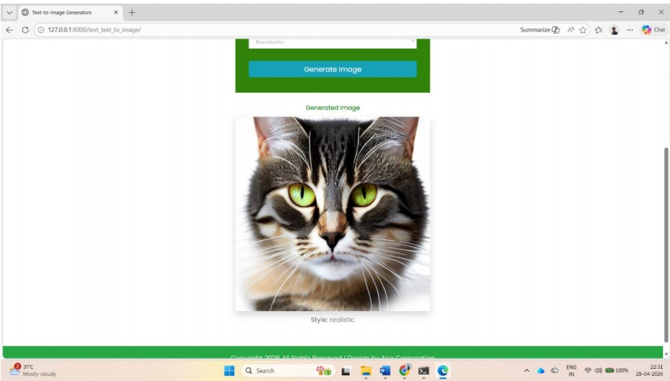
SYSTEM OUTPUT
The developed system provides a clean, interactive, and user-friendly web interface that allows users to generate high-quality images from text prompts for web page design and usability interfaces. The application is built using the Django framework and offers a seamless experience from user authentication to image generation.
User-friendly interface for interaction
Text-to-Image Generation Interface
Image Generation Process
Generated Output Display

Slide 16
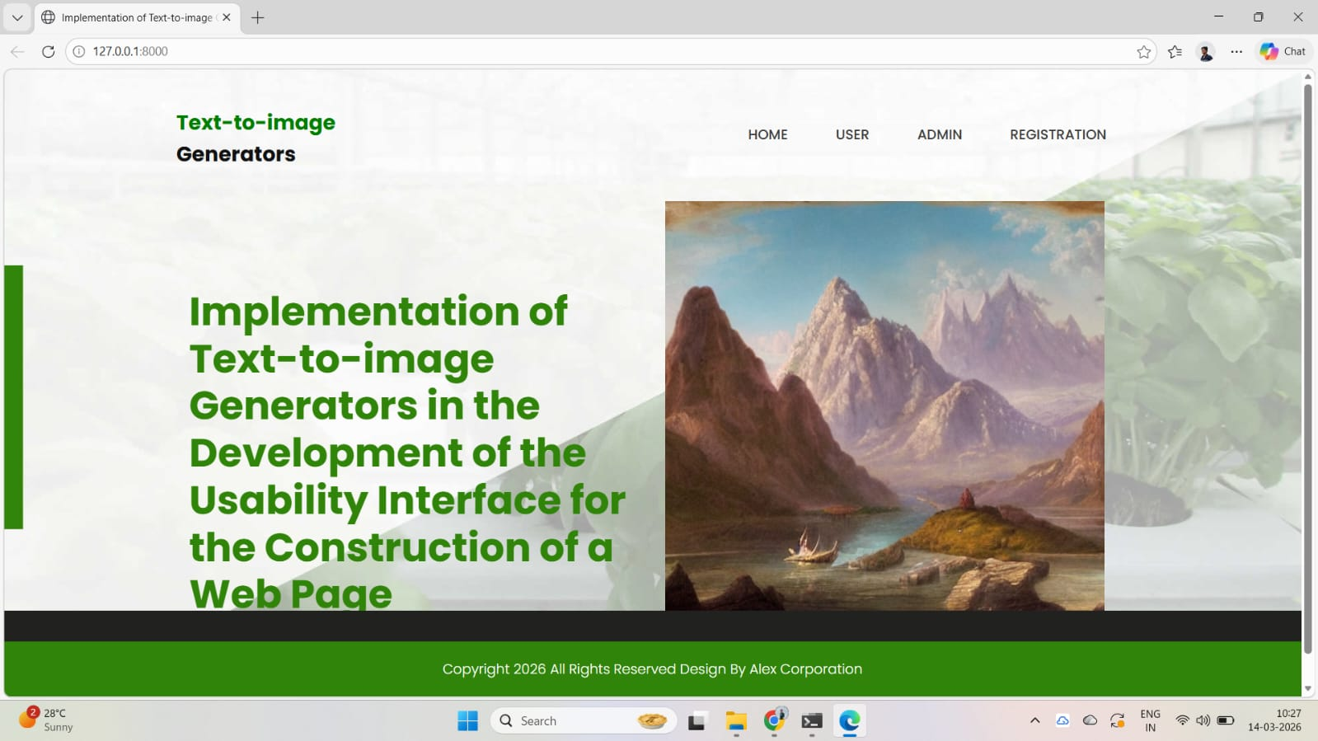
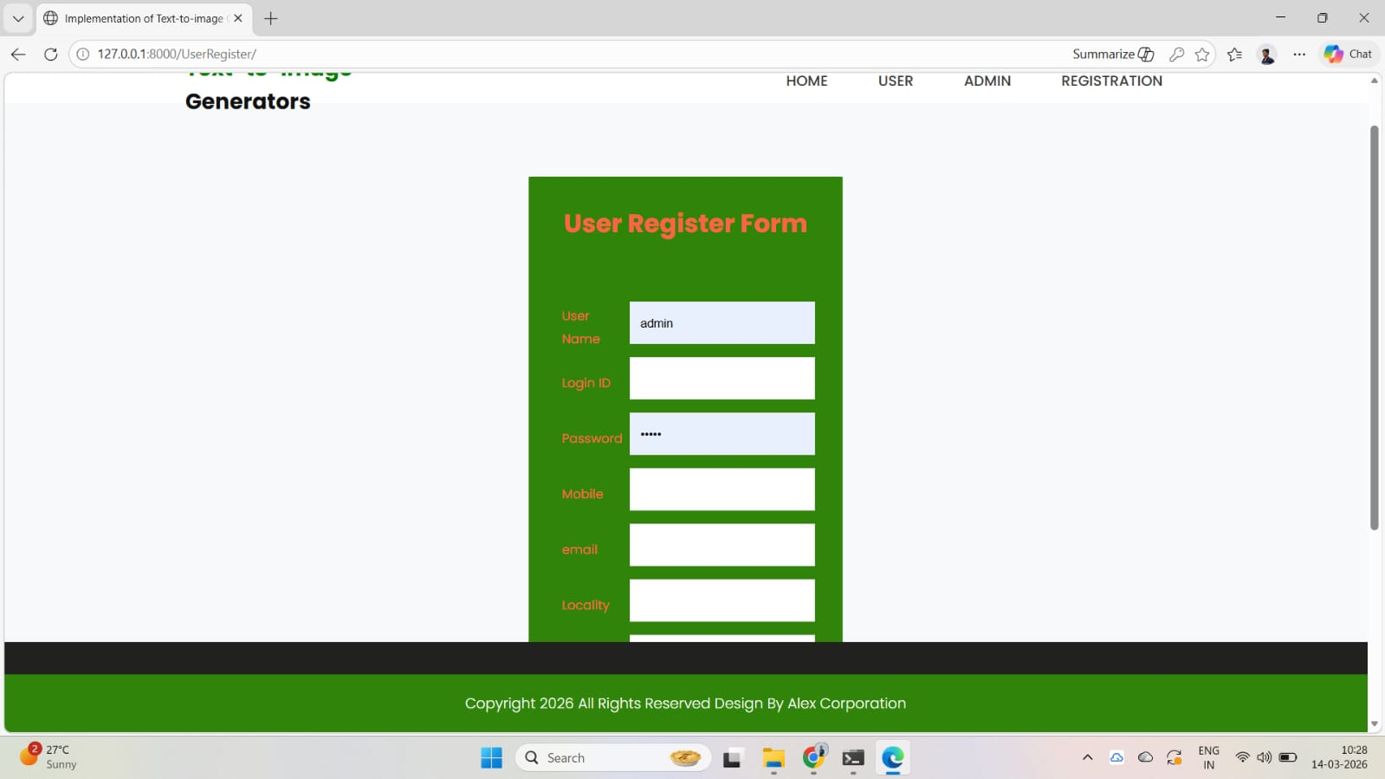
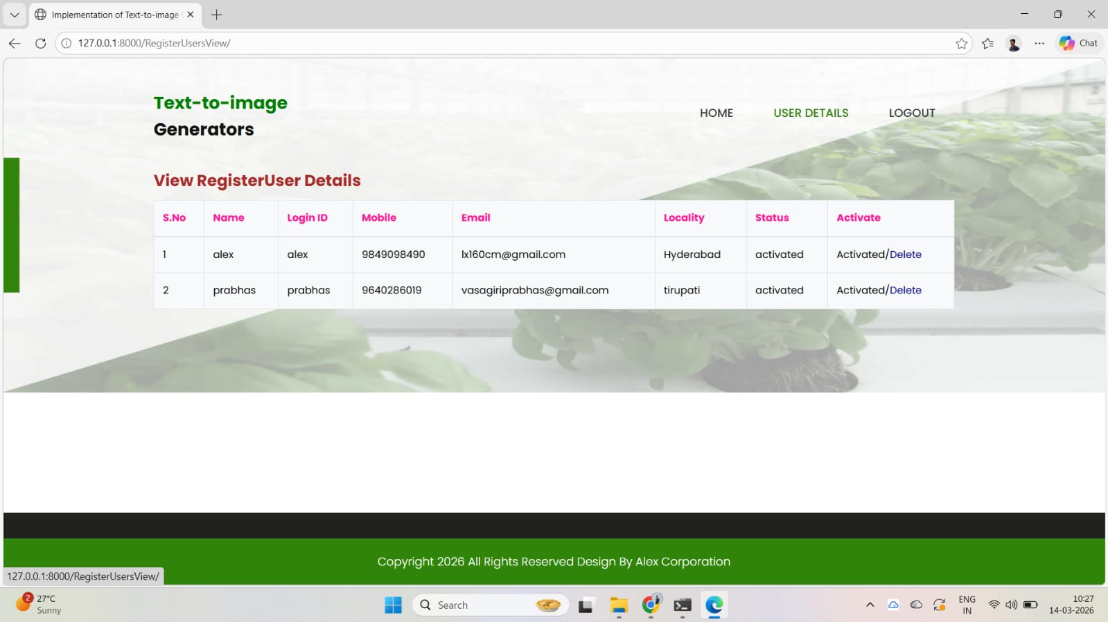

Slide 17
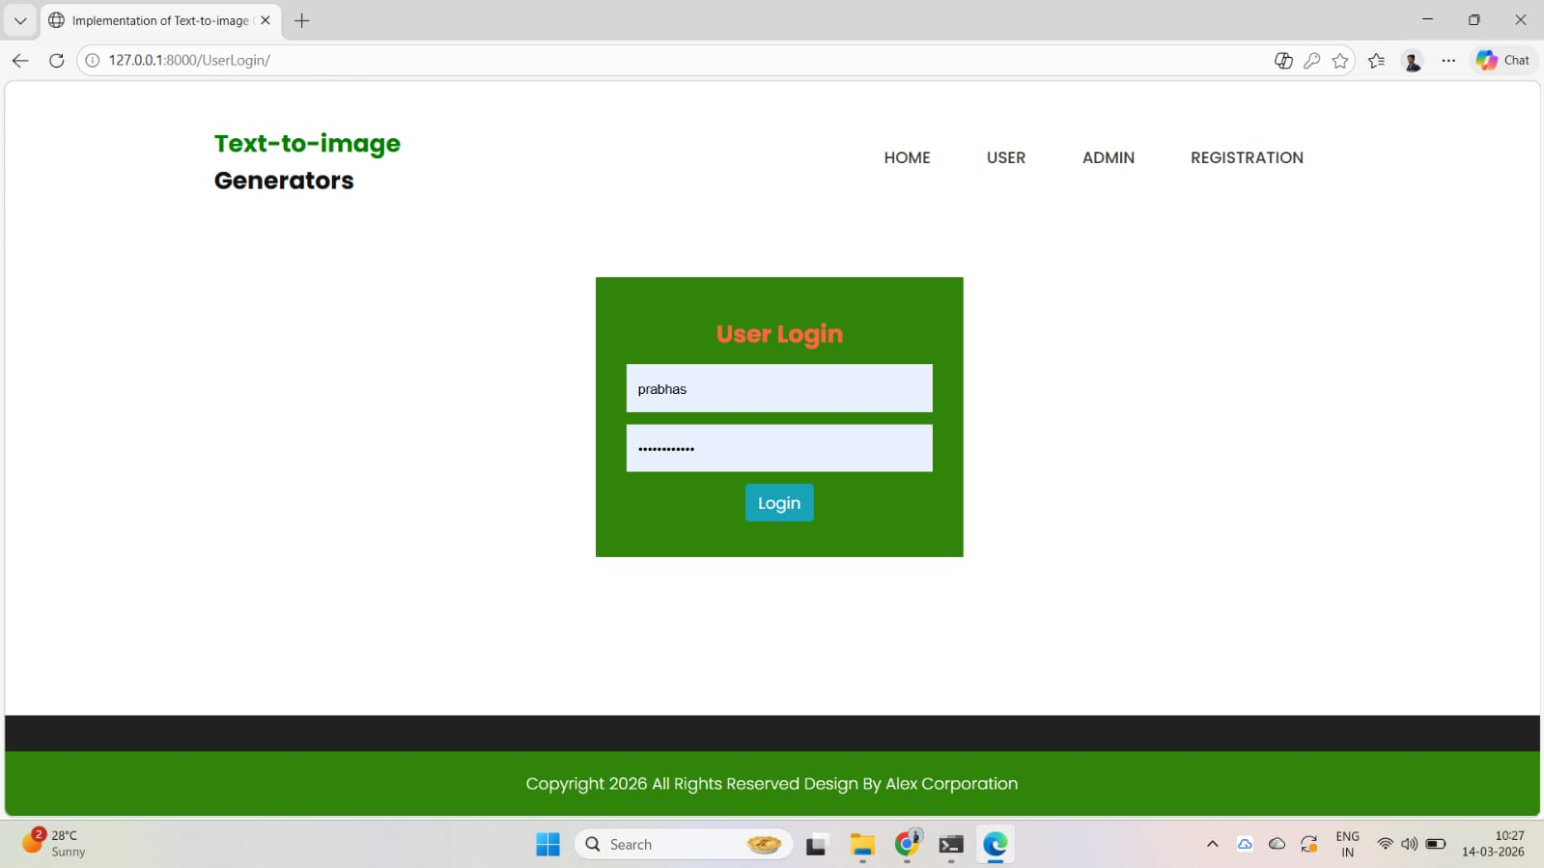
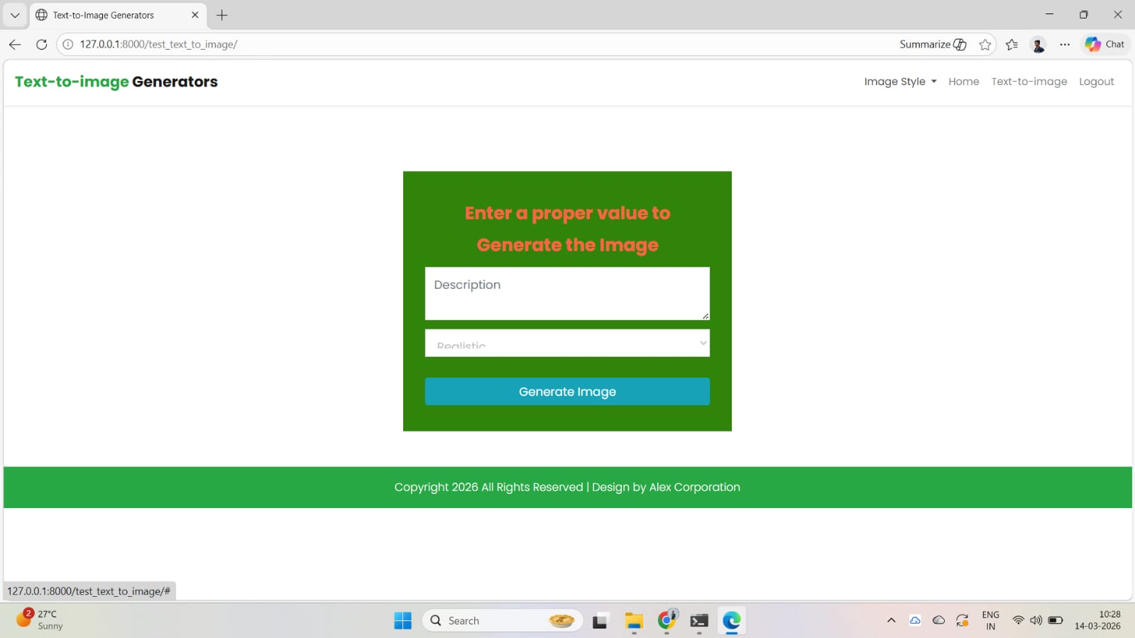

Slide 18
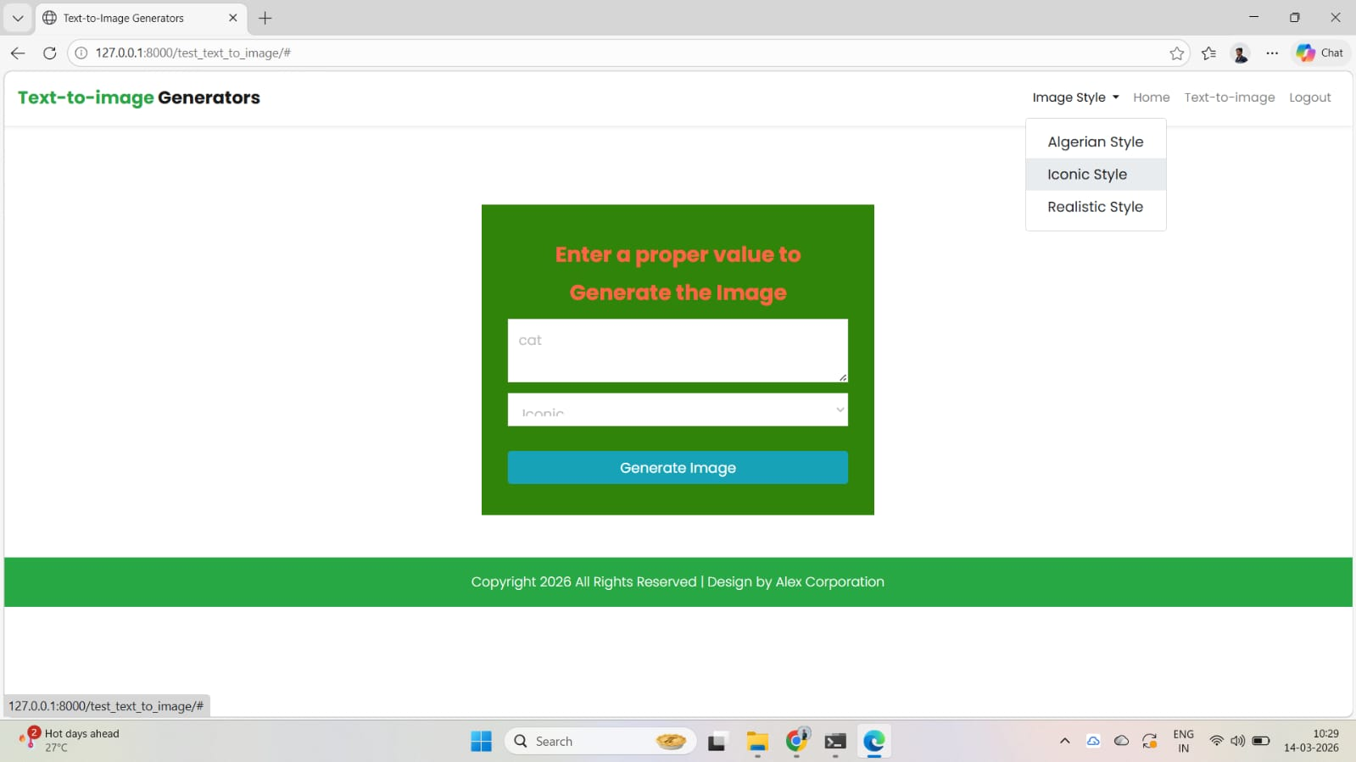
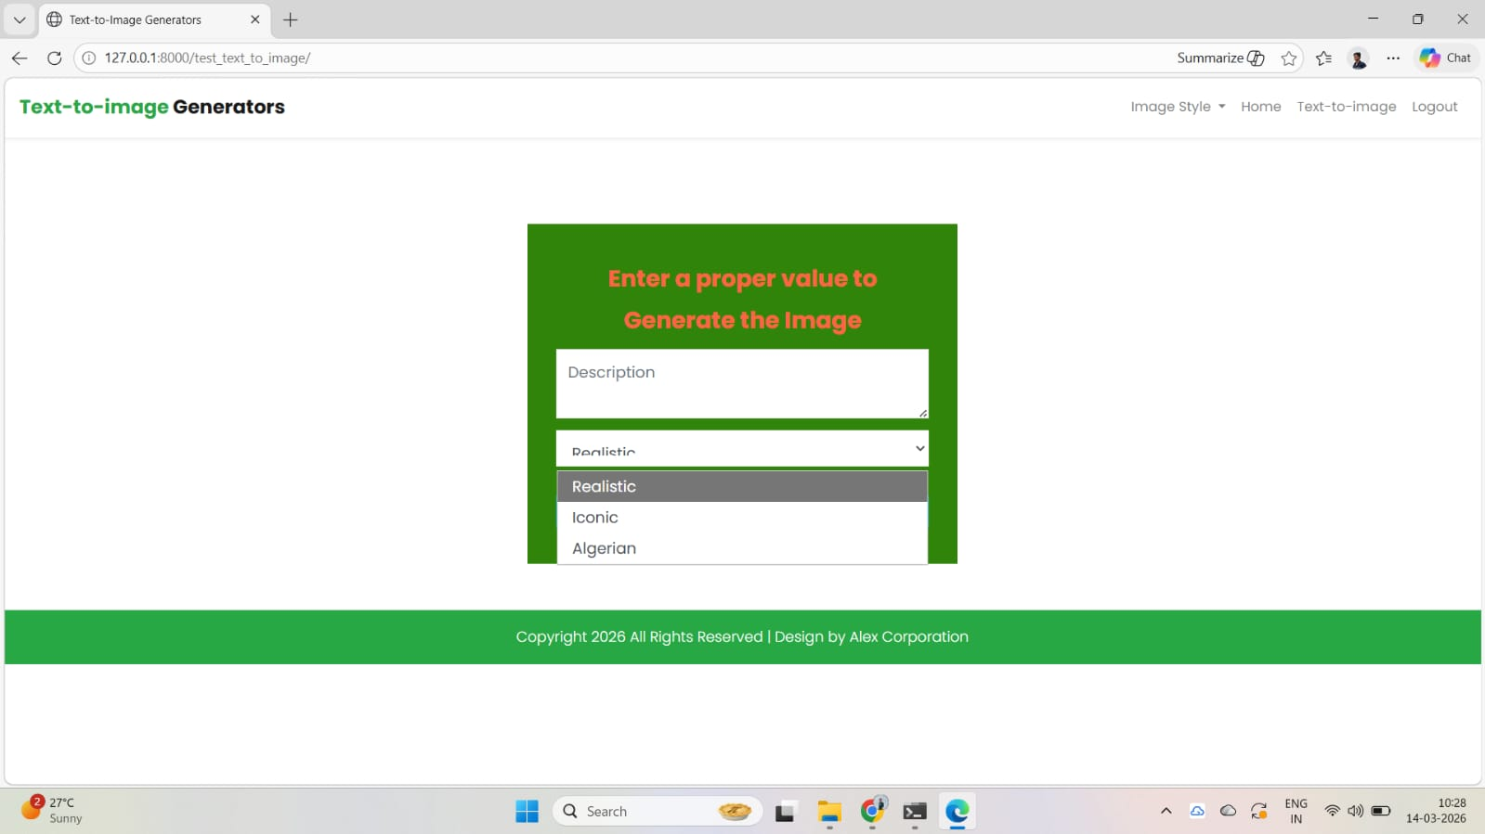

Slide 19
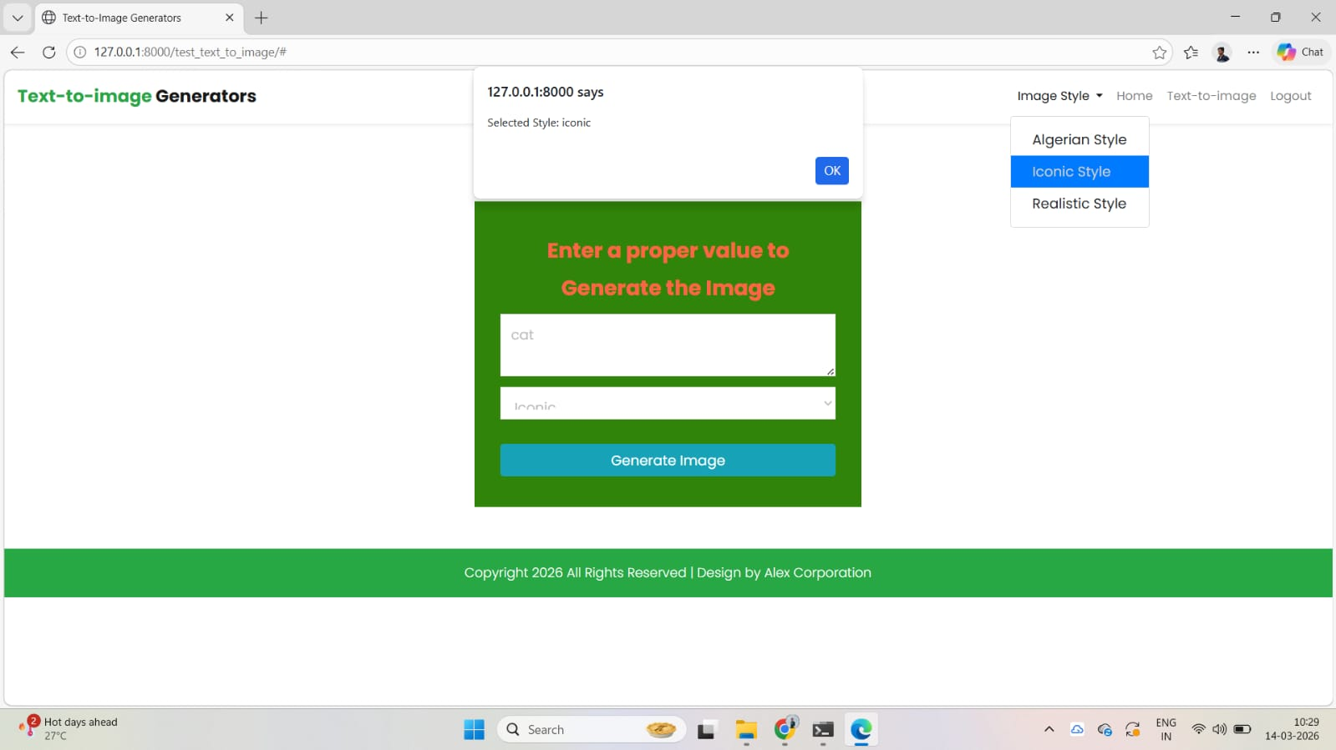

Slide 20
ADVANTAGES & APPLICATIONS
The proposed AI-Driven Text-to-Image Web Design Framework offers several significant advantages over traditional manual design methods. By integrating Generative AI (Stable Diffusion) with a user-friendly web interface, the system provides an efficient, accessible, and modern solution for visual content creation in web page construction.
Advantages:
High Speed and Efficiency
Creative Flexibility
Cost-Effective:
Automated Image Generation
Scalability
Applications:
Web Development and UI/UX Design
E-commerce Platforms:
Freelance and Small Business Design
Digital Marketing and Content Creation

Slide 21
CONCLUSION & FUTURE SCOPE
Conclusion:
The project successfully demonstrates the implementation of a Generative AI-based text-to-image generation system integrated into a user-friendly web application for designing usability interfaces in web page construction. By leveraging the Stable Diffusion model within the Django framework, the system enables users to generate high-quality, style-customized images directly from natural language textual prompts. The developed application provides essential features such as user registration, secure authentication, style selection (Realistic, Iconic, Algerian), prompt enhancement, and real-time image generation.
Future Scope:
Extend the system beyond single image generation to create complete web page layouts
Develop plugins or APIs for seamless integration with popular design tools such as Figma, Canva
Create a cross-platform mobile application to enable designers to generate and iterate on web interface visuals anytime and anywhere.

Slide 22
THANK YOU

